Slide 1
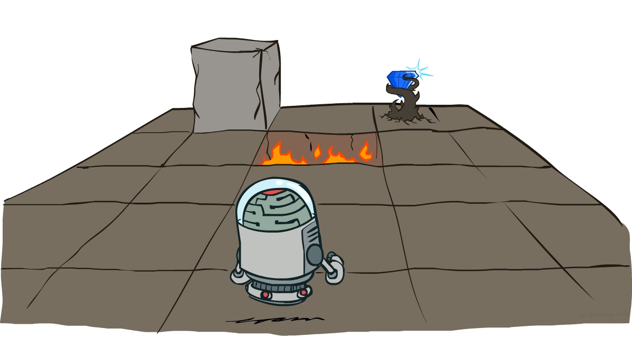
CS 4470: Artificial Intelligence
Markov Decision Processes I
Instructor: Imtiaz Parvez
Utah Valley University
[Slides adapted from George Rudolph, Dan Klein and Pieter Abbeel (ai.berkeley.edu).]
Notes:
Please retain proper attribution, including the reference to ai.berkeley.edu. Thanks!

Slide 2
Learning Outcomes
Model Sequential Decision Problems in the presence of varying levels of uncertainty
Explain the Markov Property and its impact on decision processes
Implement algorithms that have the Markov property to solve complex decision problems
Define key terms such as reward, policy, horizon, stationary, discount factor, utility, update, exploration, exploitation in the context of Markov decision Processes

Slide 3
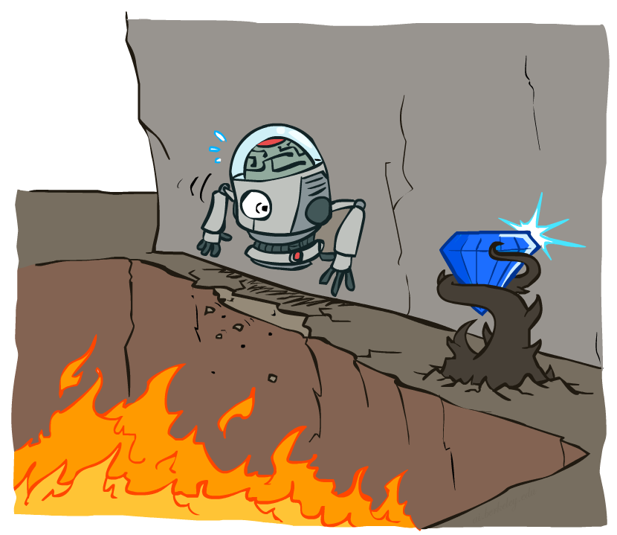
Probabilistic Search

Slide 4





Example: Grid World
A maze-like problem
The agent lives in a grid
Walls block the agent’s path
Noisy movement: actions do not always go as planned
80% of the time, the action North takes the agent North (if there is no wall there)
10% of the time, North takes the agent West; 10% East
If there is a wall in the direction the agent would have been taken, the agent stays put
The agent receives rewards each time step
Small “living” reward each step (can be negative)
Big rewards come at the end (good or bad)
Goal: maximize sum of rewards
Notes:
[cut demo of moving around in grid world program]
Terminal utilities + living reward (positive – get happier; neg – get sadder)
At exit state you must exit, the game ends, and you collect terminal utility
Don’t need to have goals – maximize happiness!

Slide 5
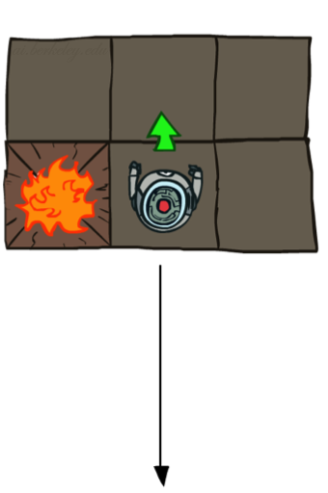
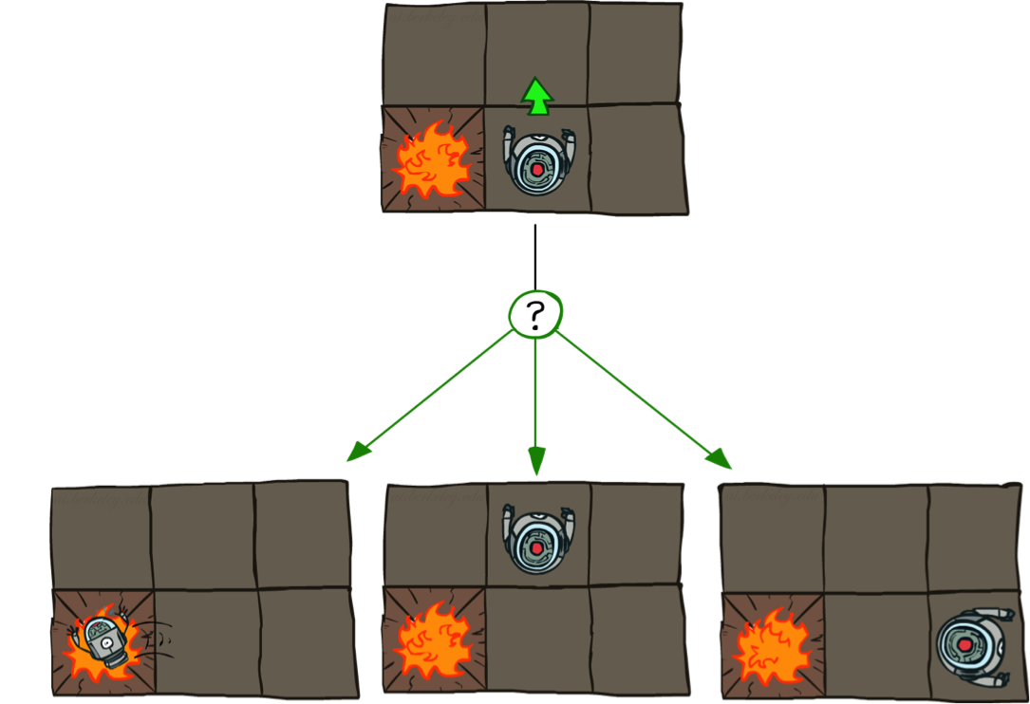

Grid World Actions
Deterministic Grid World
Stochastic Grid World

Slide 6
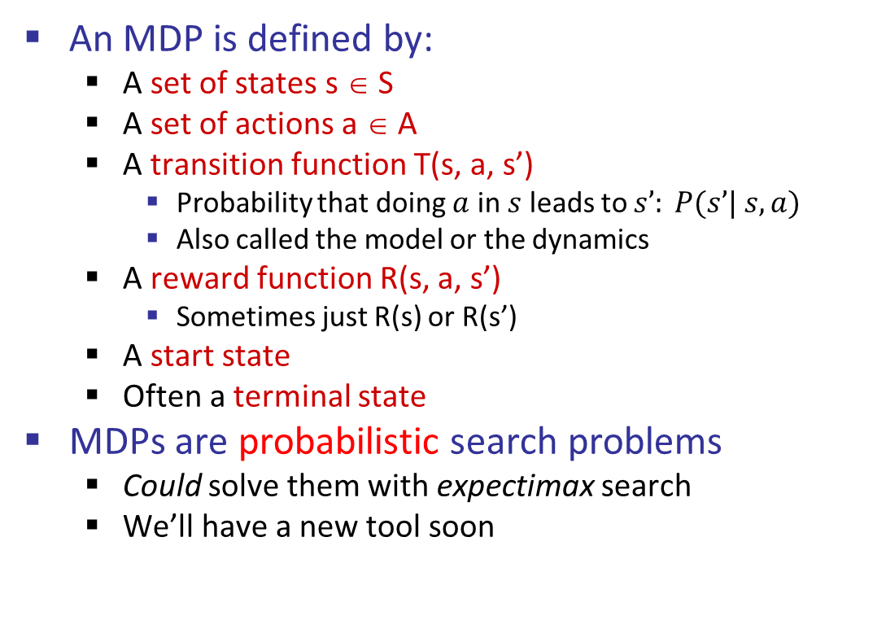
Markov Decision Processes
An MDP is defined by:
A set of states s ∈ S
A set of actions a ∈ A
A transition function T(s, a, s’)
Probability that doing $a$ in $s$ leads to $s’: P(s’| s, a)$
Also called the model or the dynamics
A reward function R(s, a, s’)
Sometimes just R(s) or R(s’)
A start state
Often a terminal state
MDPs are probabilistic search problems
Could solve them with expectimax search
We’ll have a new tool soon
[Demo – gridworld manual intro (L8D1)]
Notes:
In search problems: did not talk about actions, but about successor functions --- now the information inside the successor function is unpacked into actions, transitions and reward
Write out S, A, example entry in T, entry in R
Reward function different from the book : R(s,a,s’)
In book simpler for equations, but not useful for the projects.
Need to modify expectimax a tiny little bit to account for rewards along the way, but that’s something you should be able to do, and so you can already solve MDP’s (not in most efficient way)

Slide 7
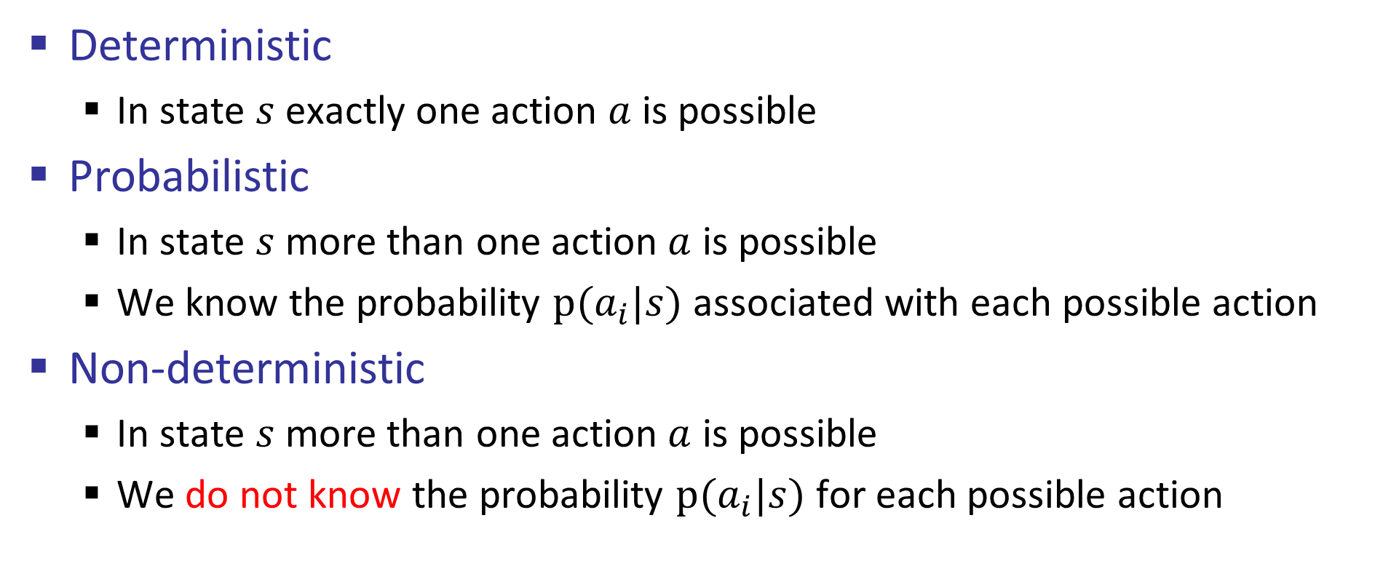
Deterministic vs Probabilistic vs. Non-deterministic
Deterministic
In state $s$exactly one action $a$ is possible
Probabilistic
In state $s$more than one action $a$ is possible
We know the probability $p(a_{i}|s)$ associated with each possible action
Non-deterministic
In state $s$more than one action $a$ is possible
We do not know the probability $p(a_{i}|s)$ for each possible action

Slide 8

Video of Demo Gridworld Manual Intro

Slide 9

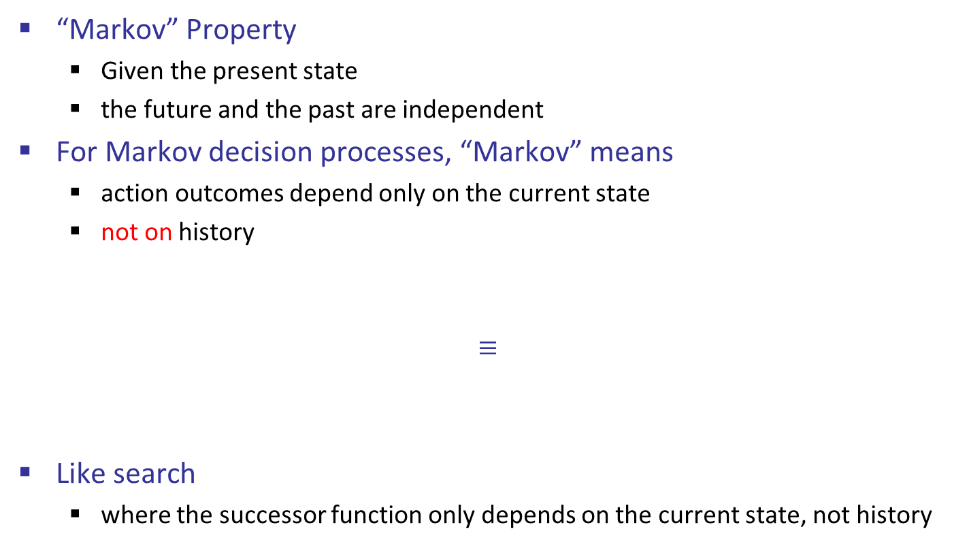
What is Markov about MDPs?
“Markov” Property
Given the present state
the future and the past are independent
For Markov decision processes, “Markov” means
action outcomes depend only on the current state
not on history
$$≡$$
Like search
where the successor function only depends on the current state, not history
Andrey Markov (1856-1922)
Notes:
Like search: successor function only depended on current state
Can make this happen by stuffing more into the state;
Very similar to search problems: when solving a maze with food pellets, we stored which food pellets were eaten

Slide 10

Policies
In deterministic single-agent search problems, we want
an optimal plan, or
sequence of actions from start to a goal
For MDPs, we want an optimal policy π*: S → A
A policy π gives an action for each state
An optimal policy is one that maximizes expected utility if followed
An explicit policy defines a reflex agent
Expectimax didn’t compute entire policies
It computed the action for a single state only
Optimal policy when R(s, a, s’) = -0.03 for all non-terminals s

Slide 11
Optimal Policies
R(s) = -0.01
R(s) = -0.03
R(s) = -0.4
R(s) = -2.0
Notes:
R(s) = the “living reward”
Note 2nd row 3rd column

Slide 12
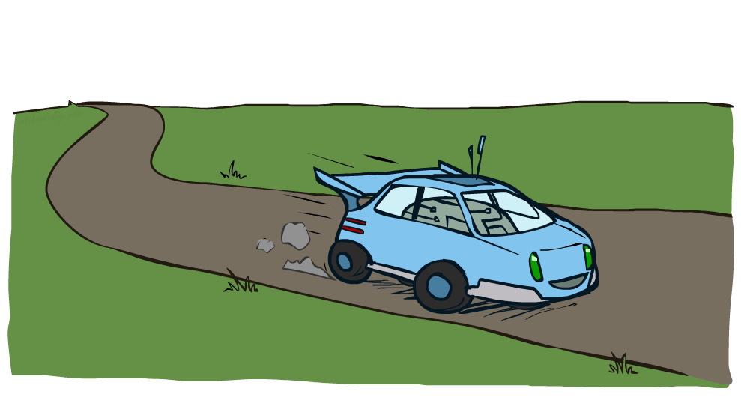
Example: Racing

Slide 13
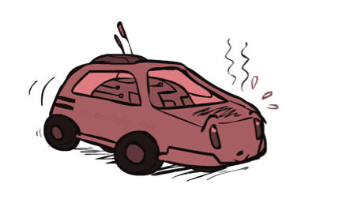
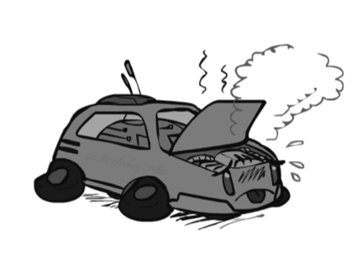

Example: Racing
A robot car wants to travel far, quickly
Three states: Cool, Warm, Overheated
Two actions: Slow, Fast
Going faster gets double reward
0.5
+1
1.0
Fast
Slow
-10
+1
0.5
Warm
Slow
Fast
0.5
+2
Cool
0.5
Overheated
+1
1.0
+2
Notes:
-10 and the game ends (important that the game ends because regardless you never want to do it)

Slide 14


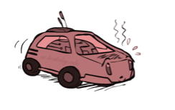
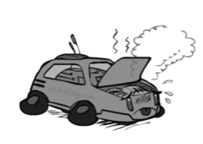
Racing Search Tree
Notes:
This looks just like expectimax
Same 3 states over and over

Slide 15
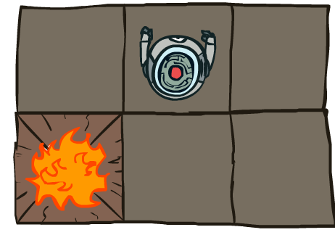


MDP Search Trees
Each MDP state projects an expectimax-like search tree
s
s is a state
a
(s, a) is a q-state
s, a
(s,a,s’) called a transition
T(s,a,s’) = P(s’|s,a)
R(s,a,s’)
s,a,s’
s’
Notes:
In MDP chance node represents uncertainty about what might happen based on (s,a) [as opposed to being a random adversary]
Q-state (s,a) is when you were in a state and took an action

Slide 16
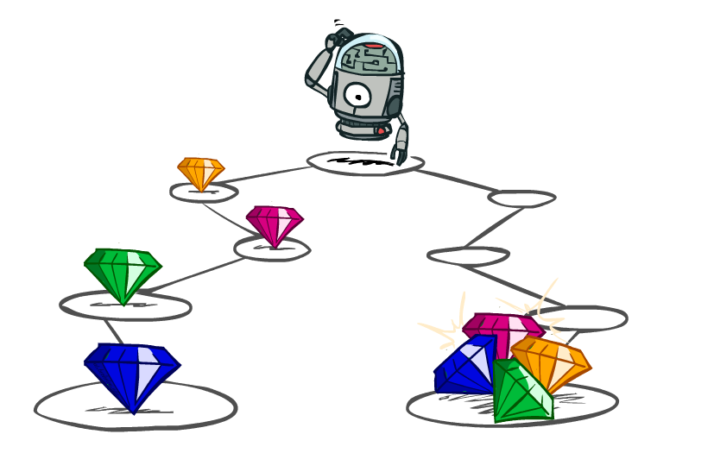
Utilities of Sequences

Slide 17
Utilities of Sequences
What preferences should an agent have over reward sequences?
More or less?
Now or later?
[1, 2, 2]
or
[2, 3, 4]
[0, 0, 1]
or
[1, 0, 0]
Notes:
Might think its easy – more or less; sure
But what about now or later; vote!

Slide 18




Discounting
It’s reasonable to maximize the sum of rewards
It’s also reasonable to prefer rewards now to rewards later
One common solution: values of rewards decay exponentially
Worth Now
Worth Next Step
Worth In Two Steps
Notes:
Inflation; really there is (1-gamma) prob of dying

Slide 19

Discounting
How to discount?
Each time we descend a level, we multiply in the discount once
Why discount?
Sooner rewards probably do have higher utility than later rewards
Also helps our algorithms converge
Example: discount of 0.5
U([1,2,3]) = 1*1 + 0.5*2 + 0.25*3
U([1,2,3]) < U([3,2,1])
Notes:
Rewards in the future (deeper in the tree) matter less
Interesting: running expectimax, if having to truncate the search, then not losing much; e.g., less then \gamma^d / (1-\gamma)
Augment q states with another option: instant death!

Slide 20
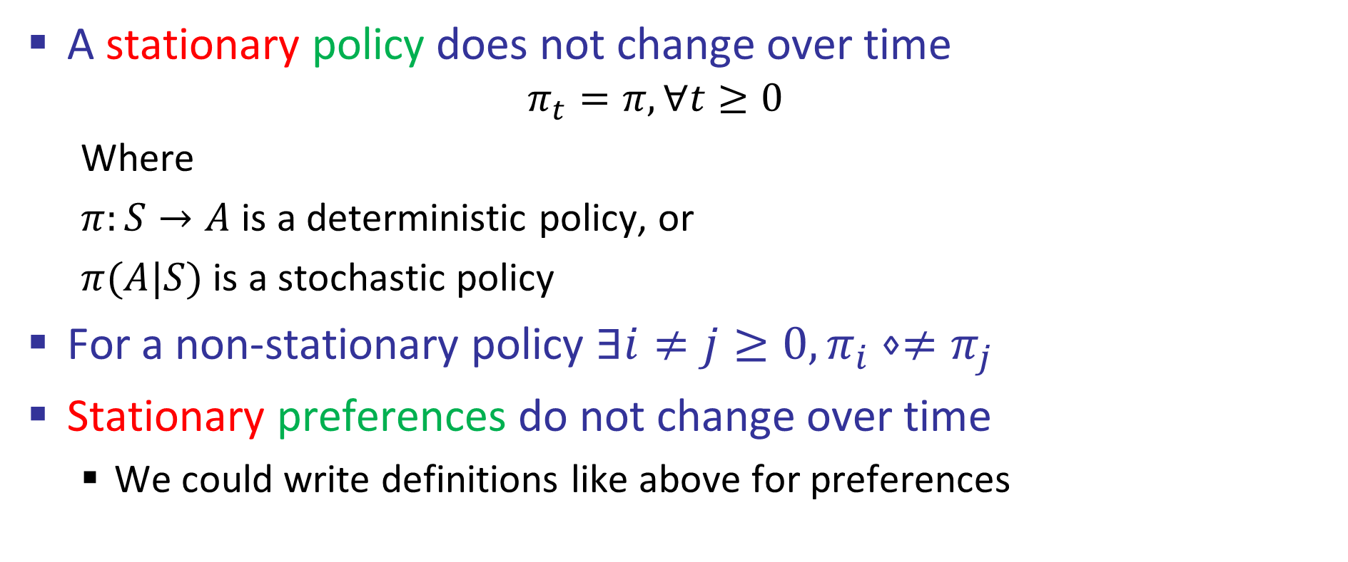
Stationary
A stationary policy does not change over time
$$π_{t}=π, ∀t≥0$$
Where
$π:S→A$ is a deterministic policy, or
$π(A|S)$ is a stochastic policy
For a non-stationary policy $∃i≠j≥0, π_{i}⋄≠π_{j}$
Stationary preferences do not change over time
We could write definitions like above for preferences

Slide 21
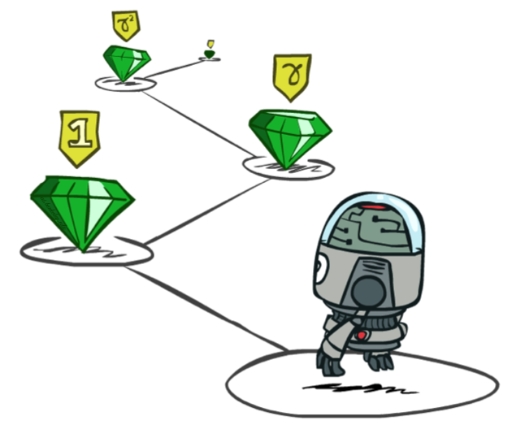
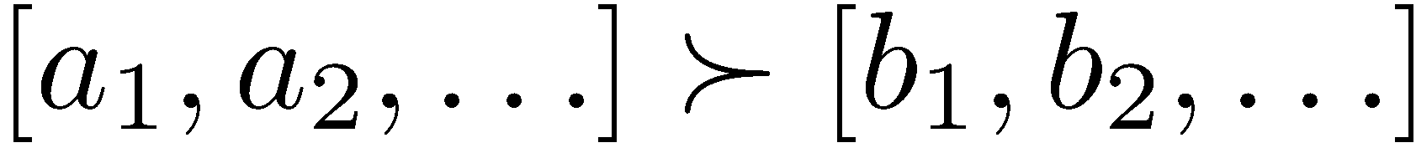
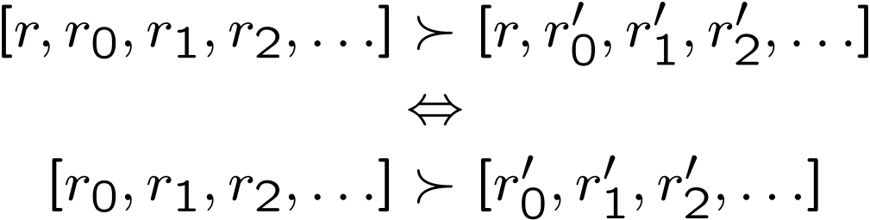
Stationary Preferences Axiom
Theorem: if we assume stationary preferences:
Then: there are only two ways to define utilities
Proof is beyond our scope
Additive utility:
Discounted utility:

Slide 22

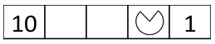
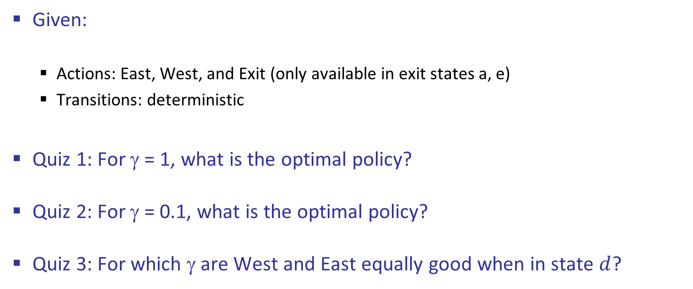
Quiz: Discounting
Given:
Actions: East, West, and Exit (only available in exit states a, e)
Transitions: deterministic
Quiz 1: For γ = 1, what is the optimal policy?
Quiz 2: For γ = 0.1, what is the optimal policy?
Quiz 3: For which γ are West and East equally good when in state $d$?

Slide 23
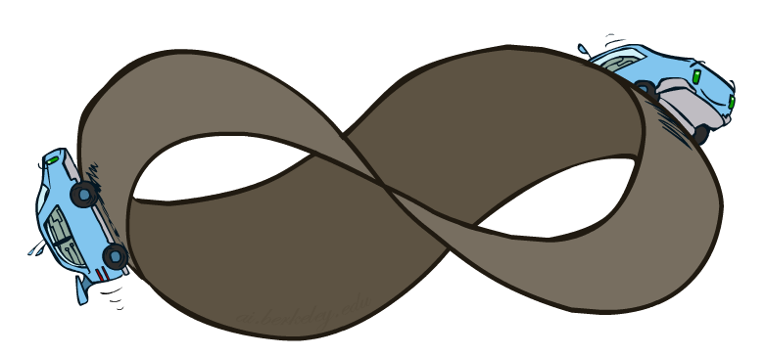
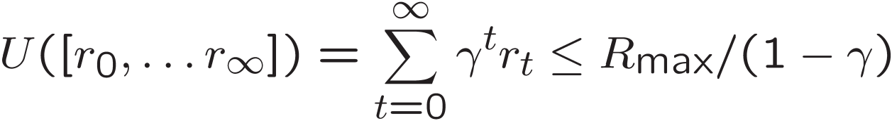
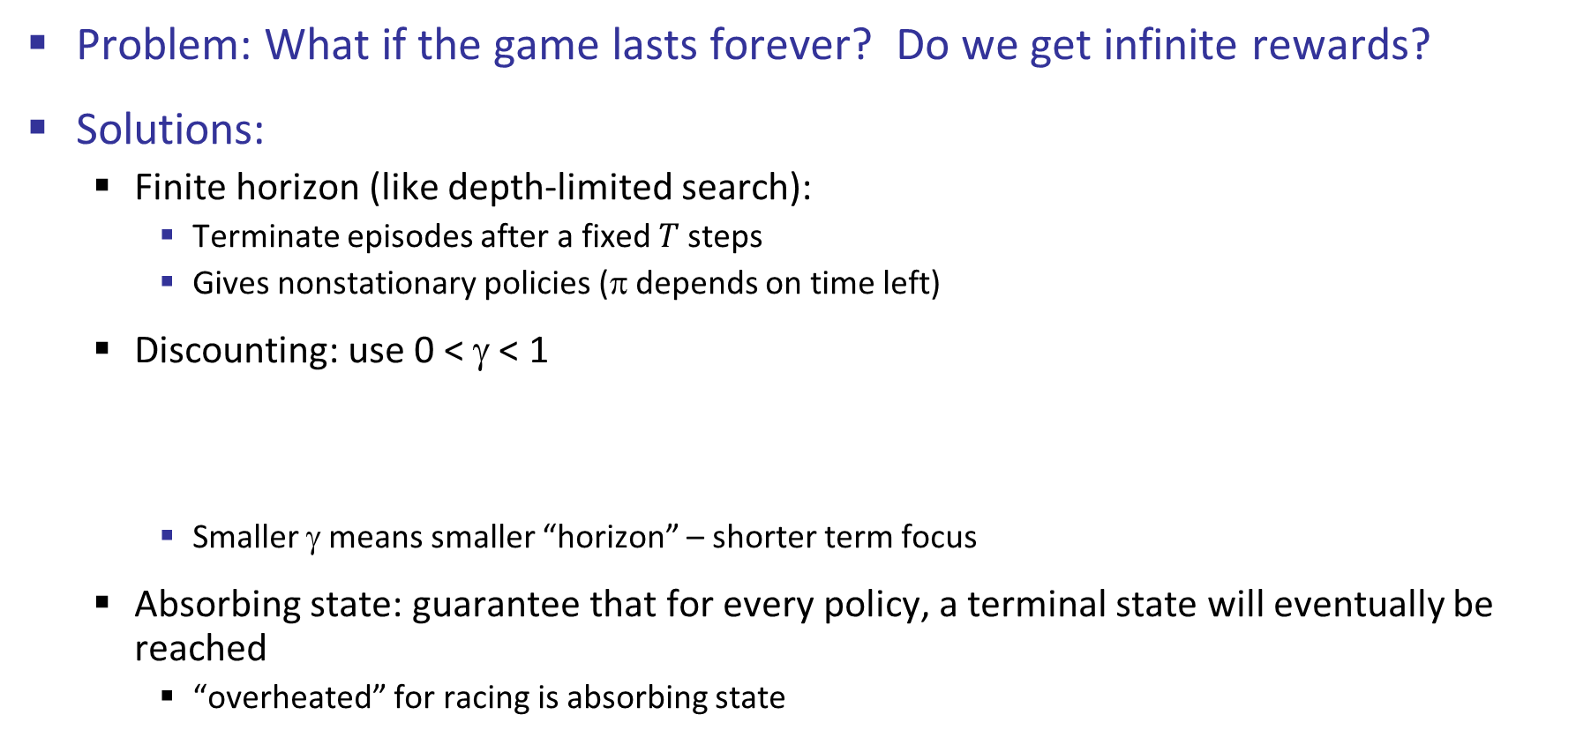
Infinite Utilities?!
Problem: What if the game lasts forever? Do we get infinite rewards?
Solutions:
Finite horizon (like depth-limited search):
Terminate episodes after a fixed $T$ steps
Gives nonstationary policies (π depends on time left)
Discounting: use 0 < γ < 1
Smaller γ means smaller “horizon” – shorter term focus
Absorbing state: guarantee that for every policy, a terminal state will eventually be reached
“overheated” for racing is absorbing state

Slide 24
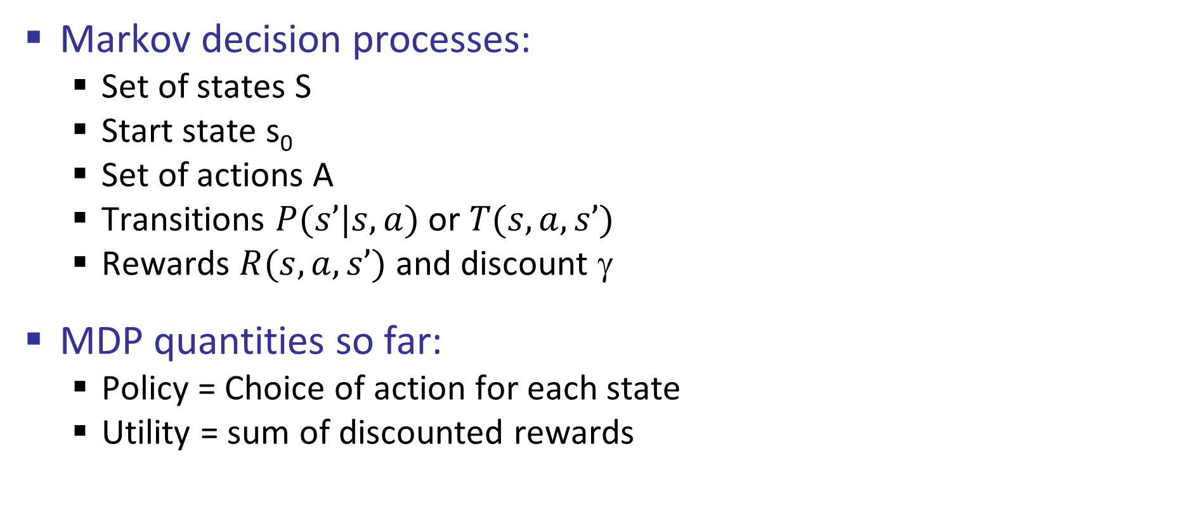
Recap: Defining MDPs
Markov decision processes:
Set of states S
Start state s₀
Set of actions A
Transitions $P(s’|s,a)$ or $T(s,a,s’)$
Rewards $R(s,a,s’)$ and discount γ
MDP quantities so far:
Policy = Choice of action for each state
Utility = sum of discounted rewards
s
a
s, a
s,a,s’
s’

Slide 25
Solving MDPs

Slide 26
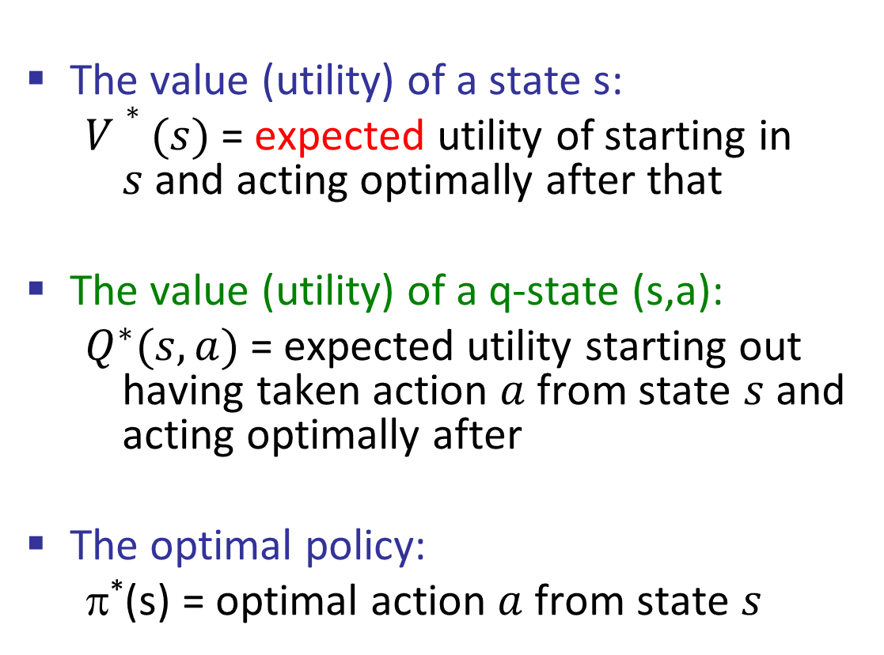
Optimal Quantities
The value (utility) of a state s:
$V∗(s)$= expected utility of starting in $s$and acting optimally after that
The value (utility) of a q-state (s,a):
$Q^{∗}(s,a)$= expected utility starting out having taken action $a$ from state $s$ and acting optimally after
The optimal policy:
π*(s) = optimal action $a$ from state $s$
s
s is a state
a
(s, a) is a q-state
s, a
s,a,s’
(s,a,s’) is a transition
s’
[Demo – gridworld values (L8D4)]
Notes:
[Note: this demo doesn’t show anything in action, just pops up V and Q values.]

Slide 27
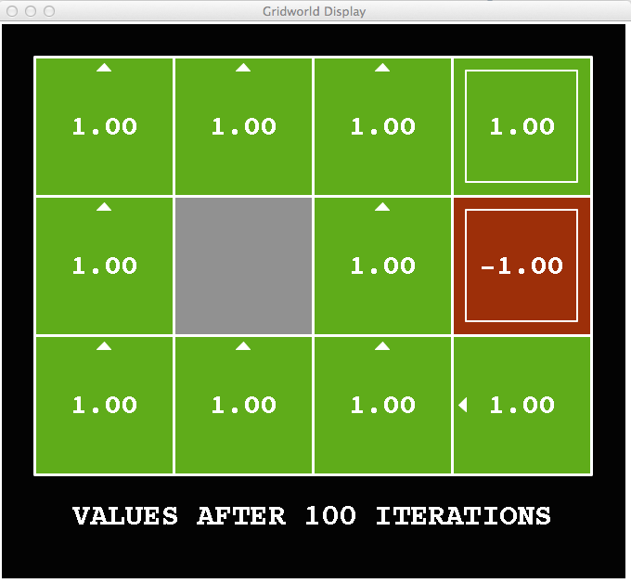
Snapshot of Demo – Gridworld V Values
Noise = 0
Discount = 1
Living reward = 0
Notes:
This demo doesn’t show anything in action, it just shows the V and Q values.

Slide 28
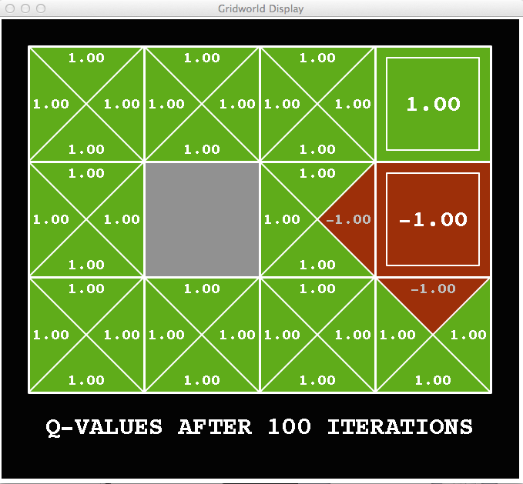
Snapshot of Demo – Gridworld Q Values
Noise = 0
Discount = 1
Living reward = 0
Notes:
This demo doesn’t show anything in action, it just shows the V and Q values.

Slide 29

Snapshot of Demo – Gridworld V Values
Noise = 0.2
Discount = 1
Living reward = 0
Notes:
This demo doesn’t show anything in action, it just shows the V and Q values.

Slide 30
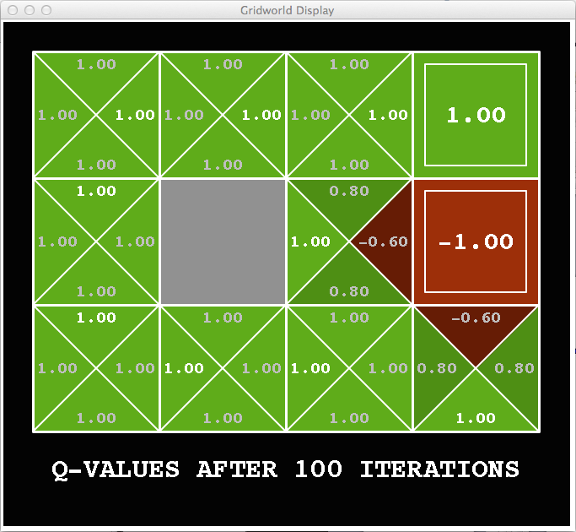
Snapshot of Demo – Gridworld Q Values
Noise = 0.2
Discount = 1
Living reward = 0
Notes:
This demo doesn’t show anything in action, it just shows the V and Q values.

Slide 31
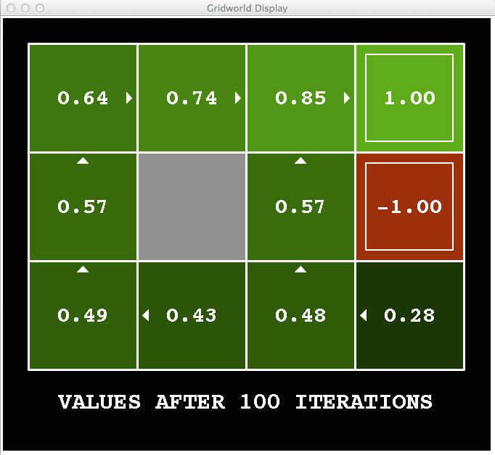
Snapshot of Demo – Gridworld V Values
Noise = 0.2
Discount = 0.9
Living reward = 0
Notes:
This demo doesn’t show anything in action, it just shows the V and Q values.

Slide 32
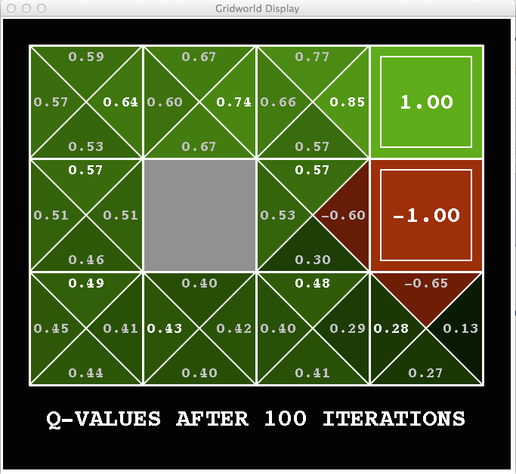
Snapshot of Demo – Gridworld Q Values
Noise = 0.2
Discount = 0.9
Living reward = 0
Notes:
This demo doesn’t show anything in action, it just shows the V and Q values.

Slide 33
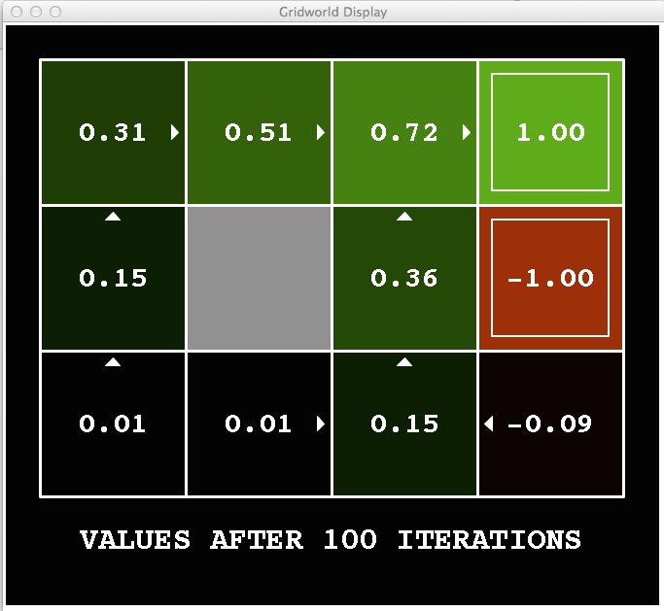
Snapshot of Demo – Gridworld V Values
Noise = 0.2
Discount = 0.9
Living reward = -0.1
Notes:
This demo doesn’t show anything in action, it just shows the V and Q values.

Slide 34
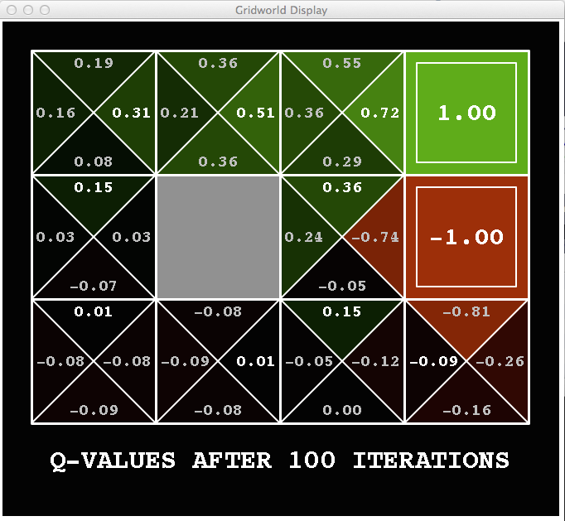
Snapshot of Demo – Gridworld Q Values
Noise = 0.2
Discount = 0.9
Living reward = -0.1
Notes:
This demo doesn’t show anything in action, it just shows the V and Q values.

Slide 35


Values of States
Fundamental operation: compute the value of a state
Expected utility under optimal action
Average sum of (discounted) rewards
This is just what expectimax computed
Recursive definition of value:
s
a
s, a
s,a,s’
s’

Slide 36
Racing Search Tree

Slide 37


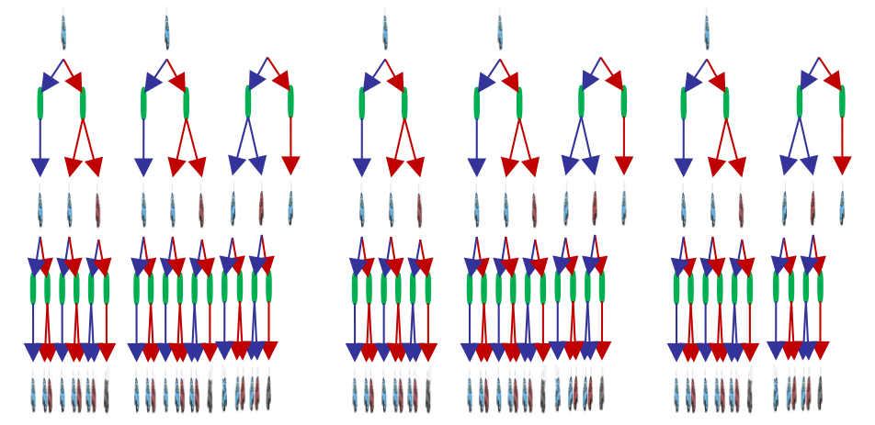

Racing Search Tree

Slide 38
Racing Search Tree
We’re doing way too much work with expectimax!
Problem: States are repeated
Idea: Only compute needed quantities once
Problem: Tree goes on forever
Idea: Do a depth-limited computation, but with increasing depths until change is small
Note: deep parts of the tree eventually don’t matter if γ < 1

Slide 39


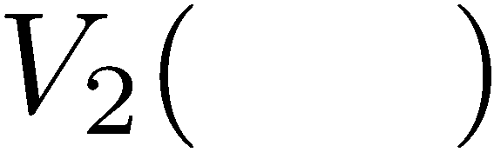

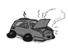
Time-Limited Values
Key idea: time-limited values
Define V_{k}(s) to be the optimal value of s if the game ends in k more time steps
Equivalently, it’s what a depth-k expectimax would give from s
[Demo – time-limited values (L8D6)]
Notes:
This demo generates the time-limited values for gridworld as snapshotted onto the next slides.

Slide 40
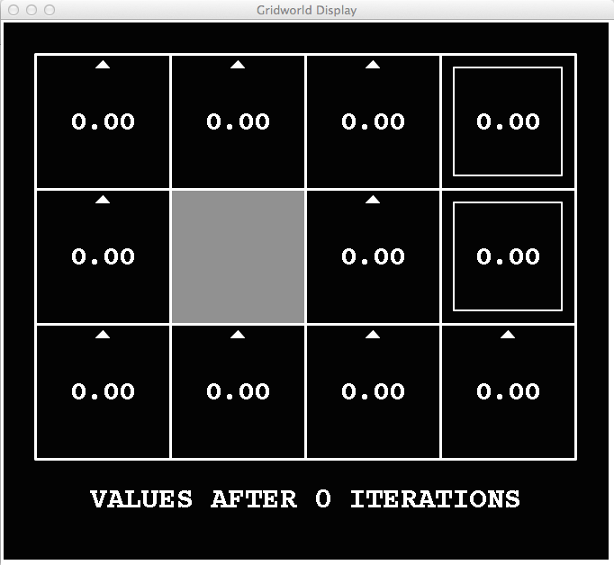
k=0
Noise = 0.2
Discount = 0.9
Living reward = 0
Notes:
Assuming zero living reward

Slide 41
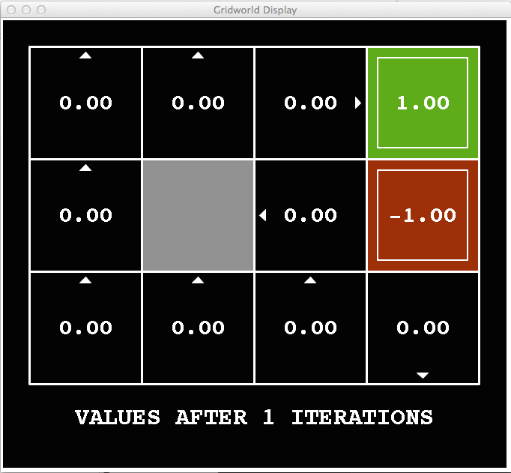
k=1
Noise = 0.2
Discount = 0.9
Living reward = 0
Notes:
Assuming zero living reward

Slide 42
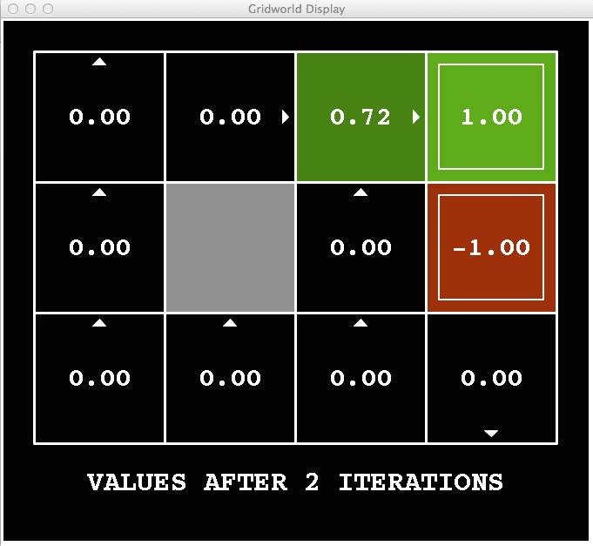
k=2
Noise = 0.2
Discount = 0.9
Living reward = 0
Notes:
Assuming zero living reward

Slide 43
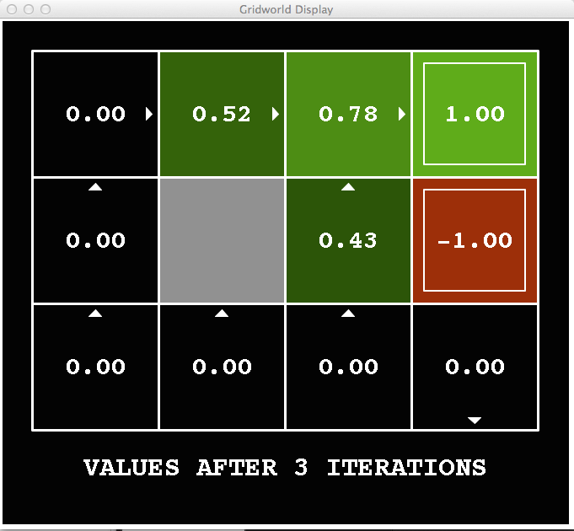
k=3
Noise = 0.2
Discount = 0.9
Living reward = 0
Notes:
Assuming zero living reward

Slide 44
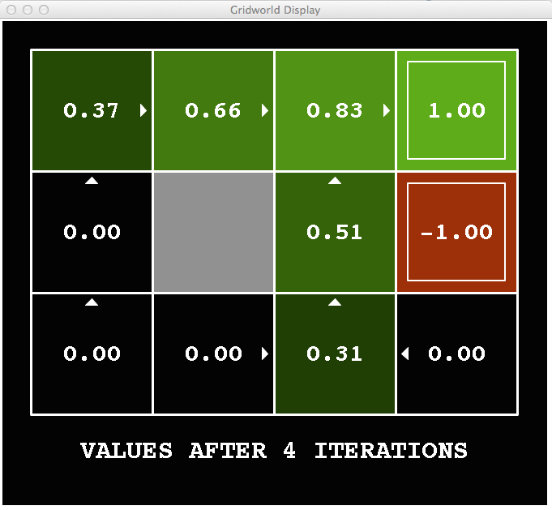
k=4
Noise = 0.2
Discount = 0.9
Living reward = 0
Notes:
Assuming zero living reward

Slide 45
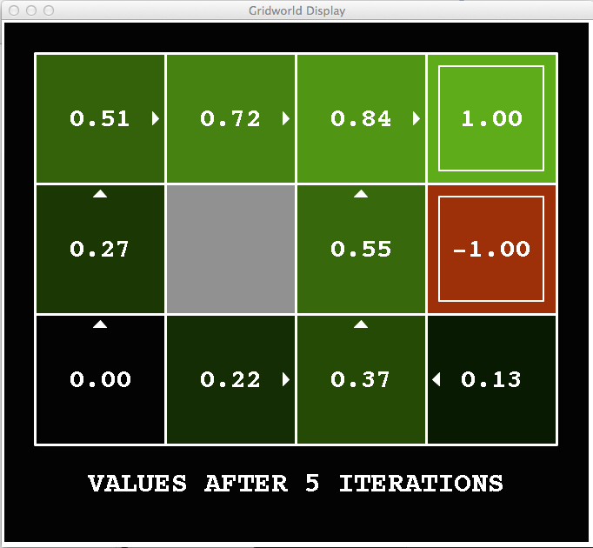
k=5
Noise = 0.2
Discount = 0.9
Living reward = 0
Notes:
Assuming zero living reward

Slide 46
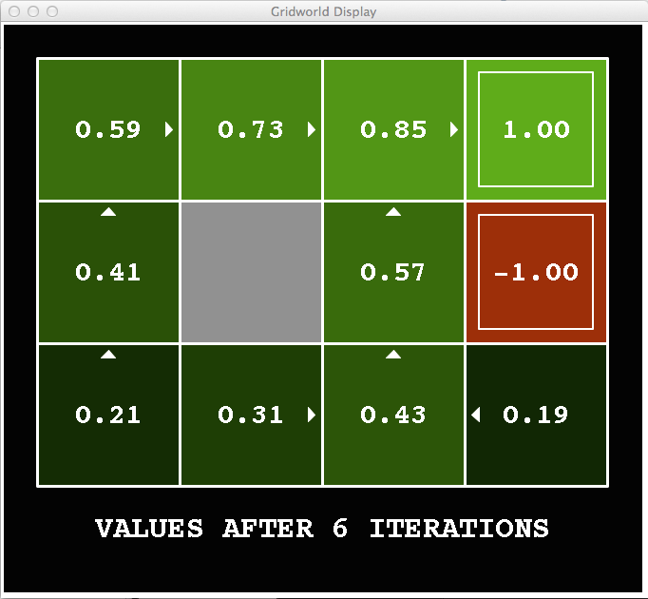
k=6
Noise = 0.2
Discount = 0.9
Living reward = 0
Notes:
Assuming zero living reward

Slide 47
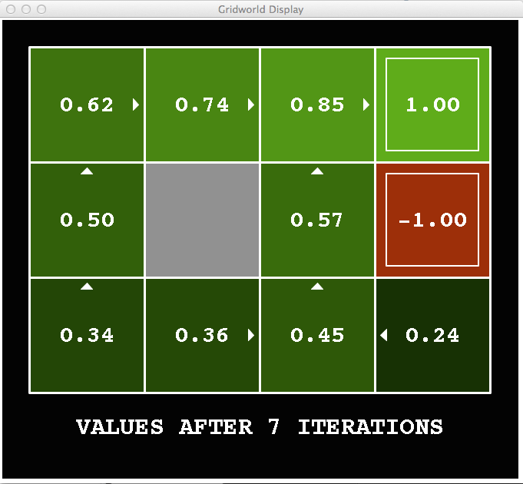
k=7
Noise = 0.2
Discount = 0.9
Living reward = 0
Notes:
Assuming zero living reward

Slide 48
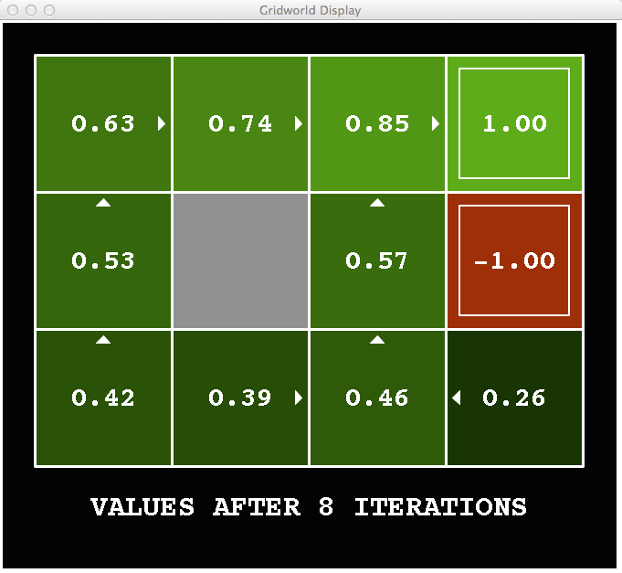
k=8
Noise = 0.2
Discount = 0.9
Living reward = 0
Notes:
Assuming zero living reward

Slide 49
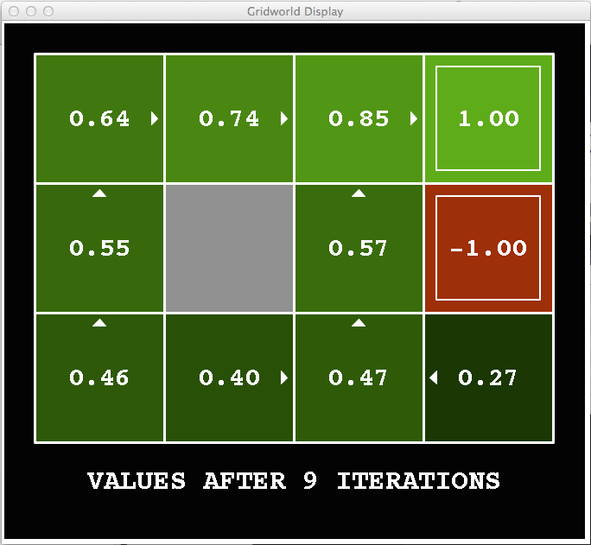
k=9
Noise = 0.2
Discount = 0.9
Living reward = 0
Notes:
Assuming zero living reward

Slide 50

k=10
Noise = 0.2
Discount = 0.9
Living reward = 0
Notes:
Assuming zero living reward

Slide 51

k=11
Noise = 0.2
Discount = 0.9
Living reward = 0
Notes:
Assuming zero living reward

Slide 52

k=12
Noise = 0.2
Discount = 0.9
Living reward = 0
Notes:
Assuming zero living reward

Slide 53

k=100
Noise = 0.2
Discount = 0.9
Living reward = 0
Notes:
Assuming zero living reward

Slide 54
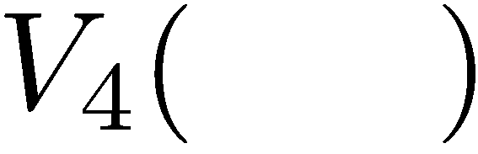

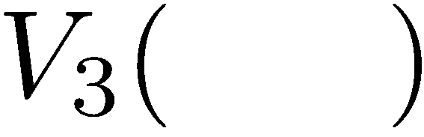
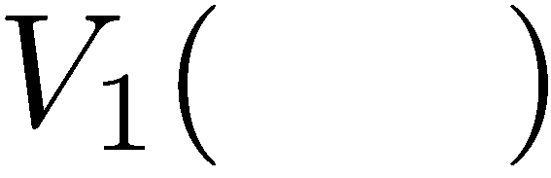
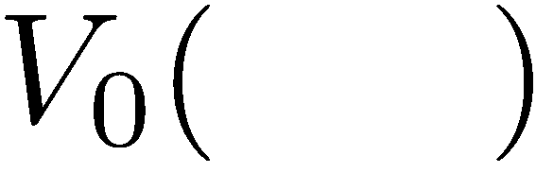
Computing Time-Limited Values

Slide 55
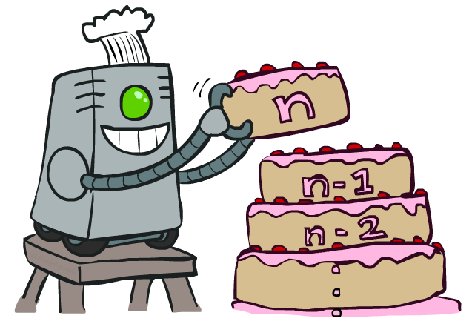
Value Iteration

Slide 56

Value Iteration
Start with V₀(s) = 0
no time steps left means an expected reward sum of zero
Given vector of V_{k}(s) values, do one ply of expectimax from each state:
Repeat #2 until convergence
Complexity of each iteration: $O(S2A)$
Theorem: will converge to unique optimal values
Basic idea: approximations get refined towards optimal values
Policy may converge long before values do
V_{k+1}(s)
a
s, a
s,a,s’
V_{k}(s’)
Notes:
Discuss computational complexity: S * A * S times number of iterations
Note: updates not in place [if in place, it means something else and not even clear what it means]

Slide 57







Example: Value Iteration
3.5 2.5 0
2 1 0
Assume no discount for simplicity
0 0 0
Notes:
Discuss computational complexity: S * A * S times number of iterations
Note: updates not in place [if in place, it means something else and not even clear what it means]

Slide 58


Convergence*
How do we know the V_{k} vectors are going to converge?
Case 1: The tree has maximum depth M
then V_{M} holds the actual untruncated values
Case 2: The discount is less than 1
Sketch: For any state V_{k} and V_{k+1} can be viewed as depth k+1 expectimax results in nearly identical search trees
The difference is that on the bottom layer, V_{k+1} has actual rewards while V_{k} has zeros
That last layer is at best all R_{MAX}
It is at worst R_{MIN}
But everything is discounted by γ^{k} that far out
So V_{k} and V_{k+1} are at most γ^{k} max|R| different
So as k increases, the values converge

Slide 59

Policy Methods

Slide 60

Policy Evaluation

Slide 61
Fixed Policies
Do the optimal action
Do what π says to do
s
s
a
π(s)
s, a
s, π(s)
s,a,s’
s, π(s),s’
s’
s’
Expectimax trees max over all actions to compute the optimal values
If we fixed some policy π(s), then the tree would be simpler – only one action per state
… though the tree’s value would depend on which policy we fixed

Slide 62
Utilities for a Fixed Policy
Another basic operation: compute the utility of a state s under a fixed (generally non-optimal) policy
Define the utility of a state s, under a fixed policy π:
V^{π}(s) = expected total discounted rewards starting in s and following π
Recursive relation (one-step look-ahead / Bellman equation):
s
π(s)
s, π(s)
s, π(s),s’
s’

Slide 63


Example: Policy Evaluation
Always Go Right
Always Go Forward

Slide 64


Example: Policy Evaluation
Always Go Right
Always Go Forward

Slide 65


Policy Evaluation
s
How do we calculate the V’s for a fixed policy π?
Idea 1: Turn recursive Bellman equations into updates
(like value iteration)
Efficiency: $O(S^{2})$per iteration
Idea 2: Without the maxes, the Bellman equations are just a linear system
Solve with your favorite linear system solver
π(s)
s, π(s)
s, π(s),s’
s’

Slide 66

Policy Extraction

Slide 67



Computing Actions from Values
Imagine we have the optimal values V*(s)
How should we act?
Look at all neighbors
Point arrow at neighbor with highest V
This is called policy extraction
it gets the policy implied by the values from

Slide 68


Computing Actions from Q-Values
Imagine we have optimal q-values:
How should we act?
Completely trivial to decide!
$π^{∗}\left(s\right)=\underset{a}{argmax}{Q^{∗}(S,a)}$
actions are easier to select from q-values than values!

Slide 69

Policy Iteration

Slide 70

Problems with Value Iteration
Value iteration repeats the Bellman updates:
Problems
It is slow – $O(S^{2}A)$per iteration
The “max” at each state rarely changes
The policy often converges long before the values
s
a
s, a
s,a,s’
s’
Notes:
Demo steps through value iteration; snapshots of values shown on next slides.

Slide 71
k=0
Noise = 0.2
Discount = 0.9
Living reward = 0
Notes:
Assuming zero living reward

Slide 72
k=1
Noise = 0.2
Discount = 0.9
Living reward = 0
Notes:
Assuming zero living reward

Slide 73
k=2
Noise = 0.2
Discount = 0.9
Living reward = 0
Notes:
Assuming zero living reward

Slide 74
k=3
Noise = 0.2
Discount = 0.9
Living reward = 0
Notes:
Assuming zero living reward

Slide 75
k=4
Noise = 0.2
Discount = 0.9
Living reward = 0
Notes:
Assuming zero living reward

Slide 76
k=5
Noise = 0.2
Discount = 0.9
Living reward = 0
Notes:
Assuming zero living reward

Slide 77
k=6
Noise = 0.2
Discount = 0.9
Living reward = 0
Notes:
Assuming zero living reward

Slide 78
k=7
Noise = 0.2
Discount = 0.9
Living reward = 0
Notes:
Assuming zero living reward

Slide 79
k=8
Noise = 0.2
Discount = 0.9
Living reward = 0
Notes:
Assuming zero living reward

Slide 80
k=9
Noise = 0.2
Discount = 0.9
Living reward = 0
Notes:
Assuming zero living reward

Slide 81
k=10
Noise = 0.2
Discount = 0.9
Living reward = 0
Notes:
Assuming zero living reward

Slide 82
k=11
Noise = 0.2
Discount = 0.9
Living reward = 0
Notes:
Assuming zero living reward

Slide 83
k=12
Noise = 0.2
Discount = 0.9
Living reward = 0
Notes:
Assuming zero living reward

Slide 84
k=100
Noise = 0.2
Discount = 0.9
Living reward = 0
Notes:
Assuming zero living reward

Slide 85
Policy Iteration
Alternative approach for optimal values:
Step 1: Policy evaluation:
calculate utilities for some fixed policy (not optimal utilities!) until convergence
Step 2: Policy improvement:
update policy using one-step look-ahead with resulting converged (but not optimal!) utilities as future values
Goto #1 until policy converges
This is policy iteration
It’s still optimal!
Can converge faster under some conditions

Slide 86
Policy Iteration
Evaluation: For fixed current policy π, find values with policy evaluation:
Iterate until values converge:
Improvement: For fixed values, get a better policy using policy extraction
One-step look-ahead:

Slide 87
Comparison
Both value iteration and policy iteration compute the same thing (all optimal values)
In value iteration:
Every iteration updates both the values and (implicitly) the policy
We don’t track the policy, but taking the max over actions implicitly recomputes it
In policy iteration:
We do several passes that update utilities with fixed policy (each pass is fast because we consider only one action, not all of them)
After the policy is evaluated, a new policy is chosen (slow like a value iteration pass)
The new policy will be better (or we’re done)
Both are dynamic programs for solving MDPs

Slide 88
Summary: MDP Algorithms
When you want to…
These all look the same
Compute optimal values
use value iteration or policy iteration
Compute values for a particular policy:
use policy evaluation
Turn your values into a policy:
use policy extraction (one-step lookahead)
They are all variations of Bellman updates
They all use one-step lookahead expectimax fragments
They differ only in whether we plug in a fixed policy or max over actions

